Slide 1
Evaluating Electricity Generation from Coal and Natural Gas: A Predictive Analysis of Future AQI Index
Yewon Lee, George Jiang, and Christine Sangphet
DS 598 Project Presentation
Fall 2024

Slide 2
Table of contents
01
03
02
04
Introduction
Power BI Demo
Problem Statement
Objectives
Data Architecture
Walkthrough of our Power BI dashboard
Data Analysis
Conclusion
EDA
Descriptive Analytics
Diagnostic Analytics
Predictive Analytics
Prescriptive Analytics
Recommendations

Slide 3
01
Introduction

Slide 4
Problem Statement
Objective:
Explore the impact of nonrenewable energy generation from coal and natural gas on air quality (AQI).
Focus on two regions: Los Angeles (LA) and New England (NE).
Key Problems:
LA: Higher AQI during summer due to wildfires, heat, and energy peaks.
NE: Stable AQI but winter peaks due to natural gas heating.
Why It Matters:
Poor AQI → Increased health risks (e.g., respiratory diseases).
Climate change worsens these patterns (wildfires, extreme heat).
Need for sustainable energy solutions.

Slide 5
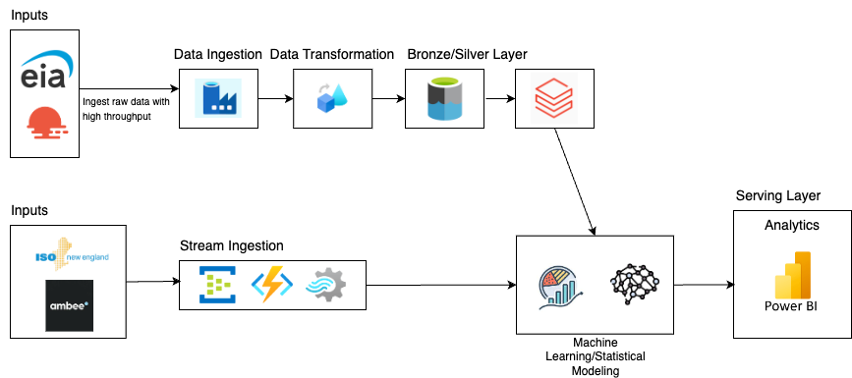
Data Architecture

Slide 6
02
Data Analysis

Slide 7
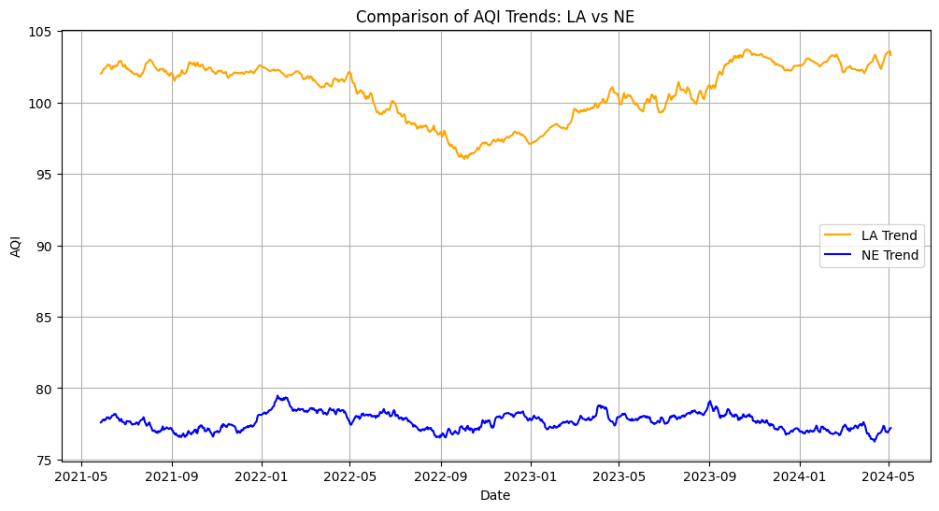
Exploratory Data Analysis (EDA)
Augmented Dickey-Fuller test
 | ISO New England AQI | Los Angeles Department of Water and Power AQI
Test Statistics | -4.930804 | -4.197508
Critical Value (ɑ = 0.05) | -2.863583 | -2.863578
p-value | 0.000030 | 0.000665

Slide 8
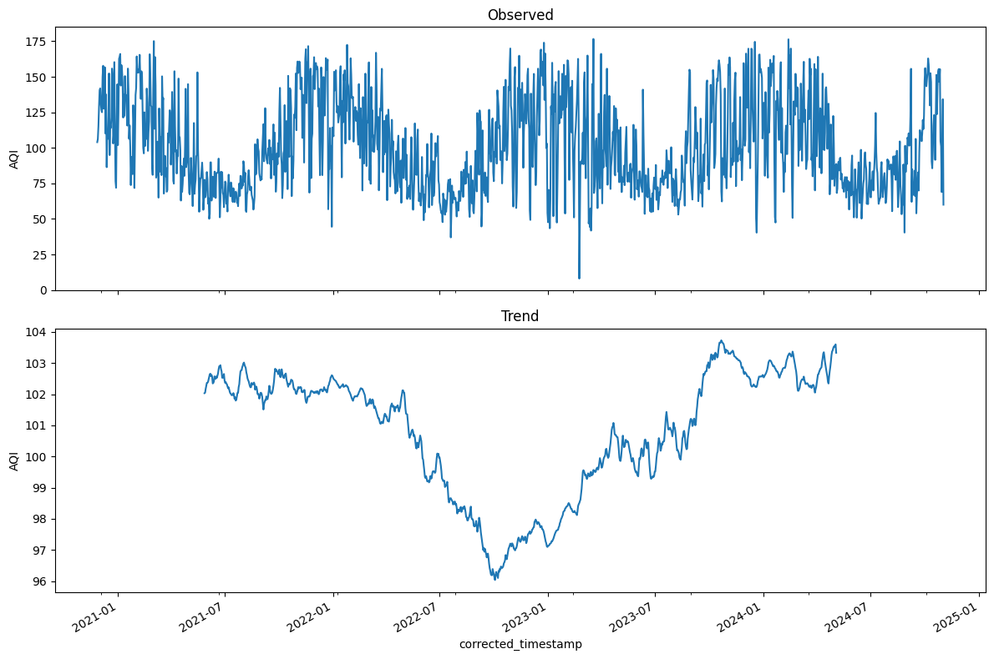
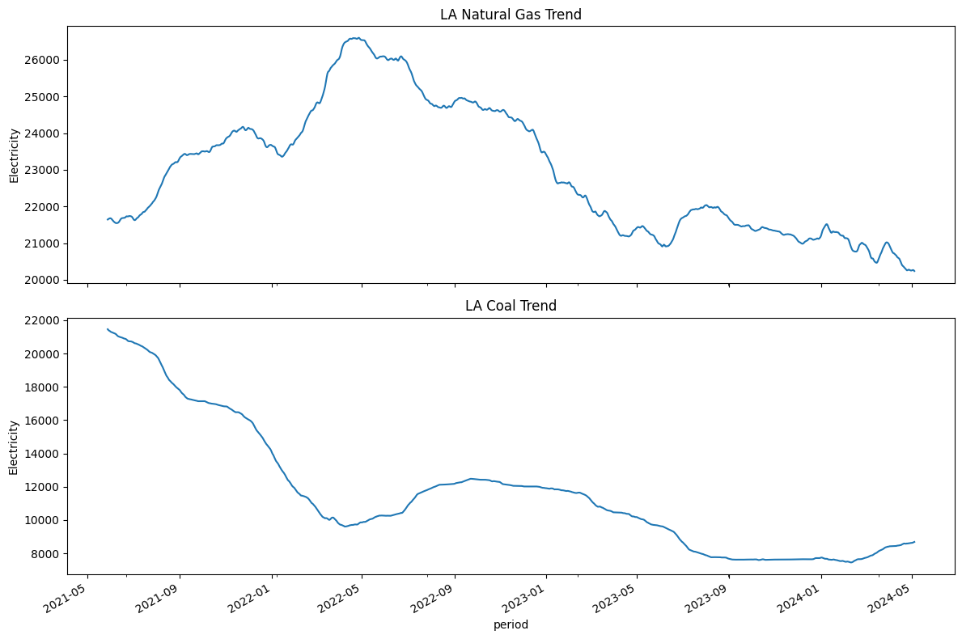
Los Angeles Analysis

Slide 9
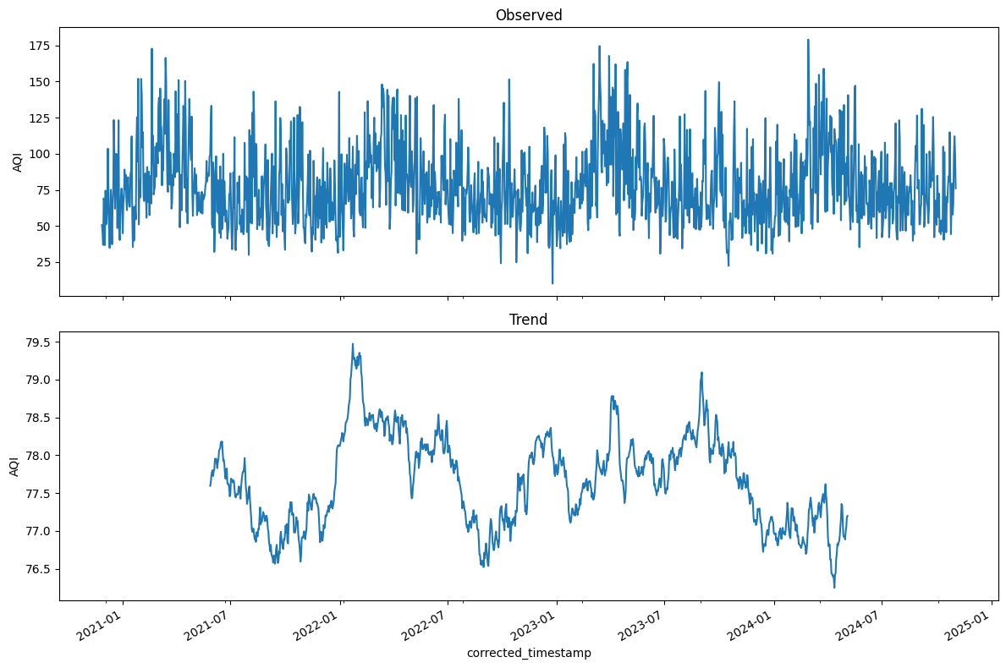
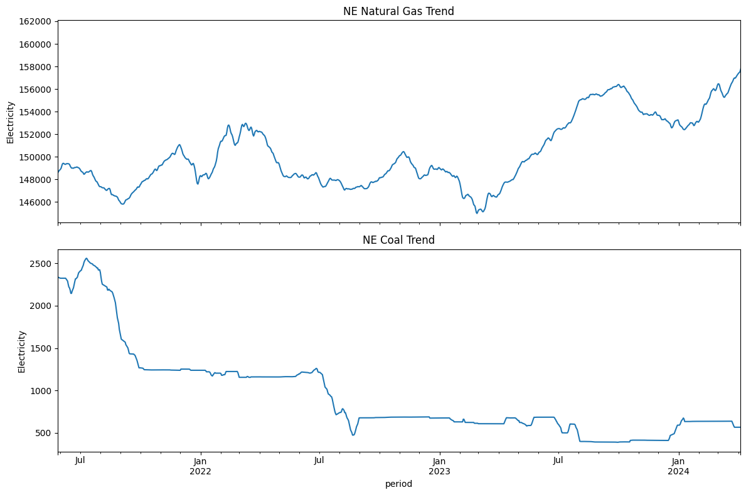
New England Analysis

Slide 10
03
Power BI Demo

Slide 11
Dashboard
Power BI Dashboard Download Link: https://github.com/george962/EnergyAQAnalysis/blob/main/PowerBi/Team1_Dashboard.pbix

Slide 12
03
Conclusion

Slide 13
Recommendations
For Policymakers:
Grid Modernization & Energy Storage:
Upgrade energy grids to support renewable energy.
Enhance energy storage infrastructure for stable supply during peak demand.
Invest in advanced battery technologies & smart grid systems for improved efficiency and reliability.
Mitigating Urban Heat Islands with Smart City Design:
Address urban heat island effect with smart city technologies.
Implement reflective pavements, green spaces, and rooftop gardens to reduce temperatures & absorb CO2.
Launch a "smart cooling" initiative to monitor temperature & air quality, dynamically adjusting systems to improve public health.
For the Public:
Localized Air Quality Sensors & Personal Tracking:
Deploy low-cost air quality sensors in urban & rural areas.
Integrate sensors with wearable devices for real-time exposure tracking.
Use mobile app alerts to guide actions like staying indoors during poor air quality.
Empower public health officials to focus pollution-reduction efforts more effectively.

Slide 14
Thanks!
OFF
ON

